Slide 1

Exercise 4 Logic Circuits
Gog Andreea Alexandra
Group 913

Slide 2
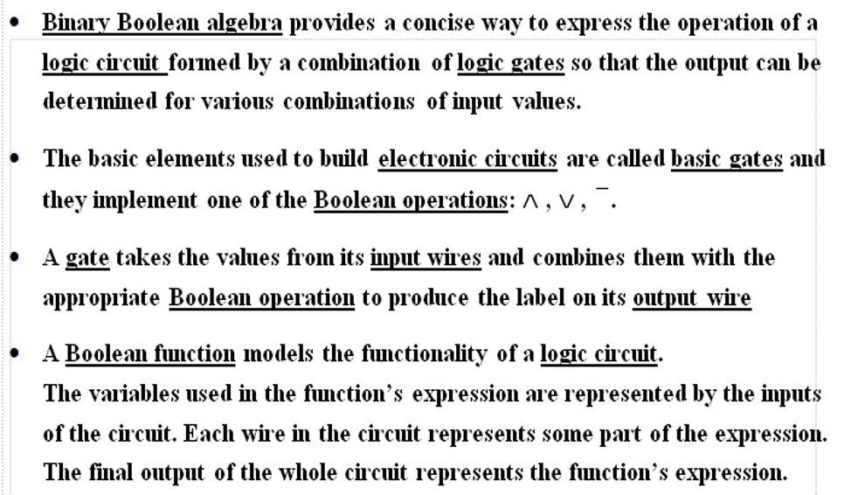

Slide 3
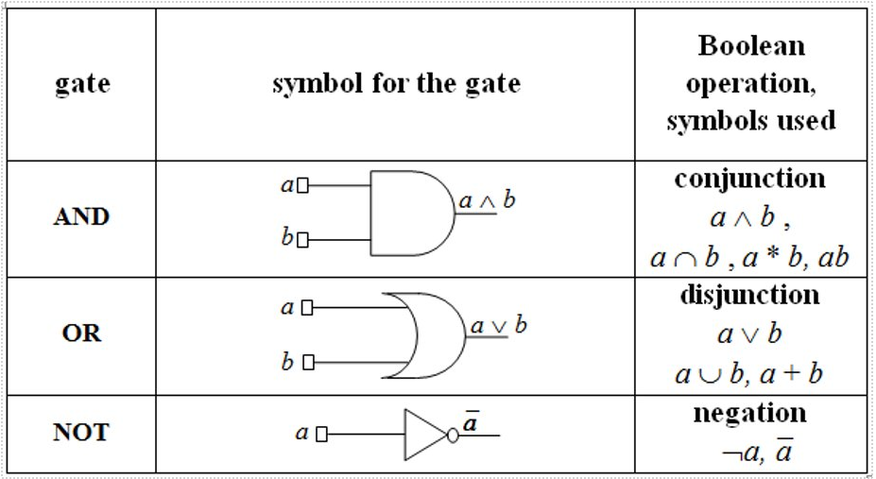

Slide 4
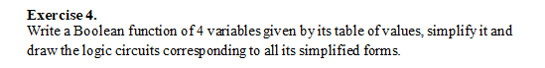
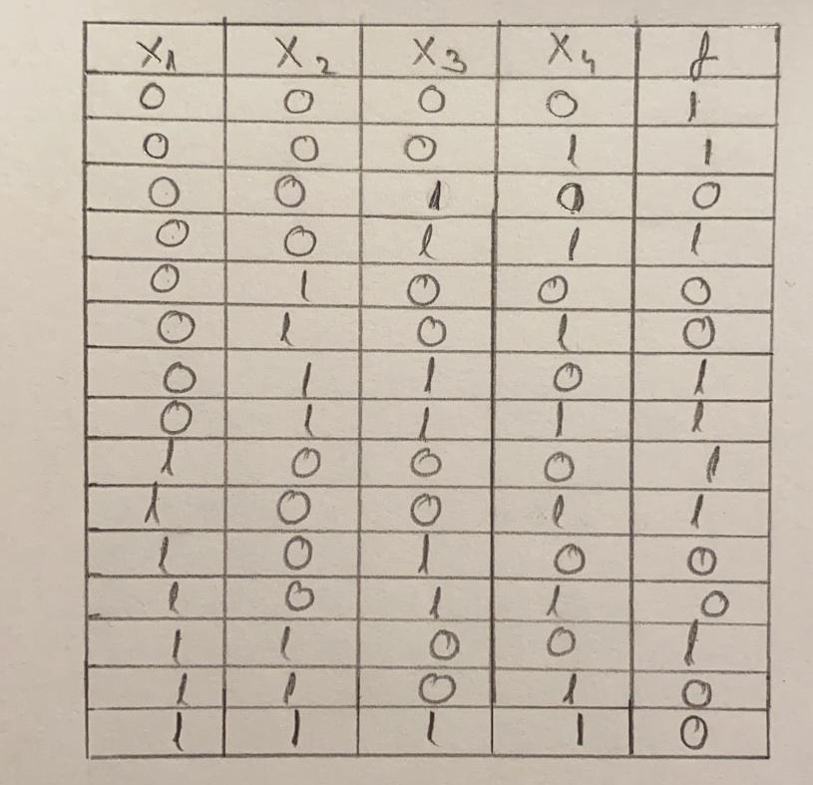
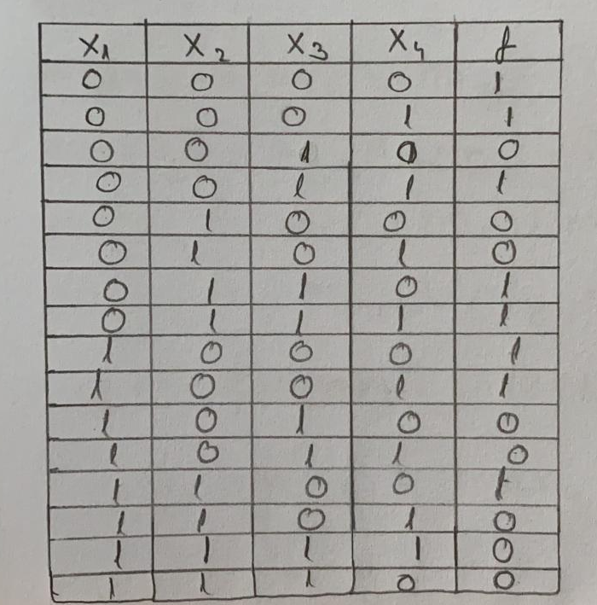

At first, we take a Boolean function of 4 variables ($x_{1,}$ $x_{2}$ $x_{3}$ $x_{4}$) and then we build the table of values

Slide 5
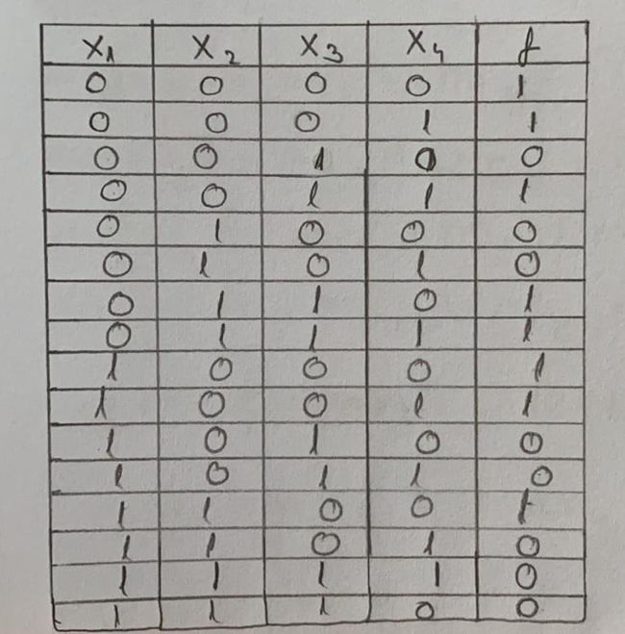
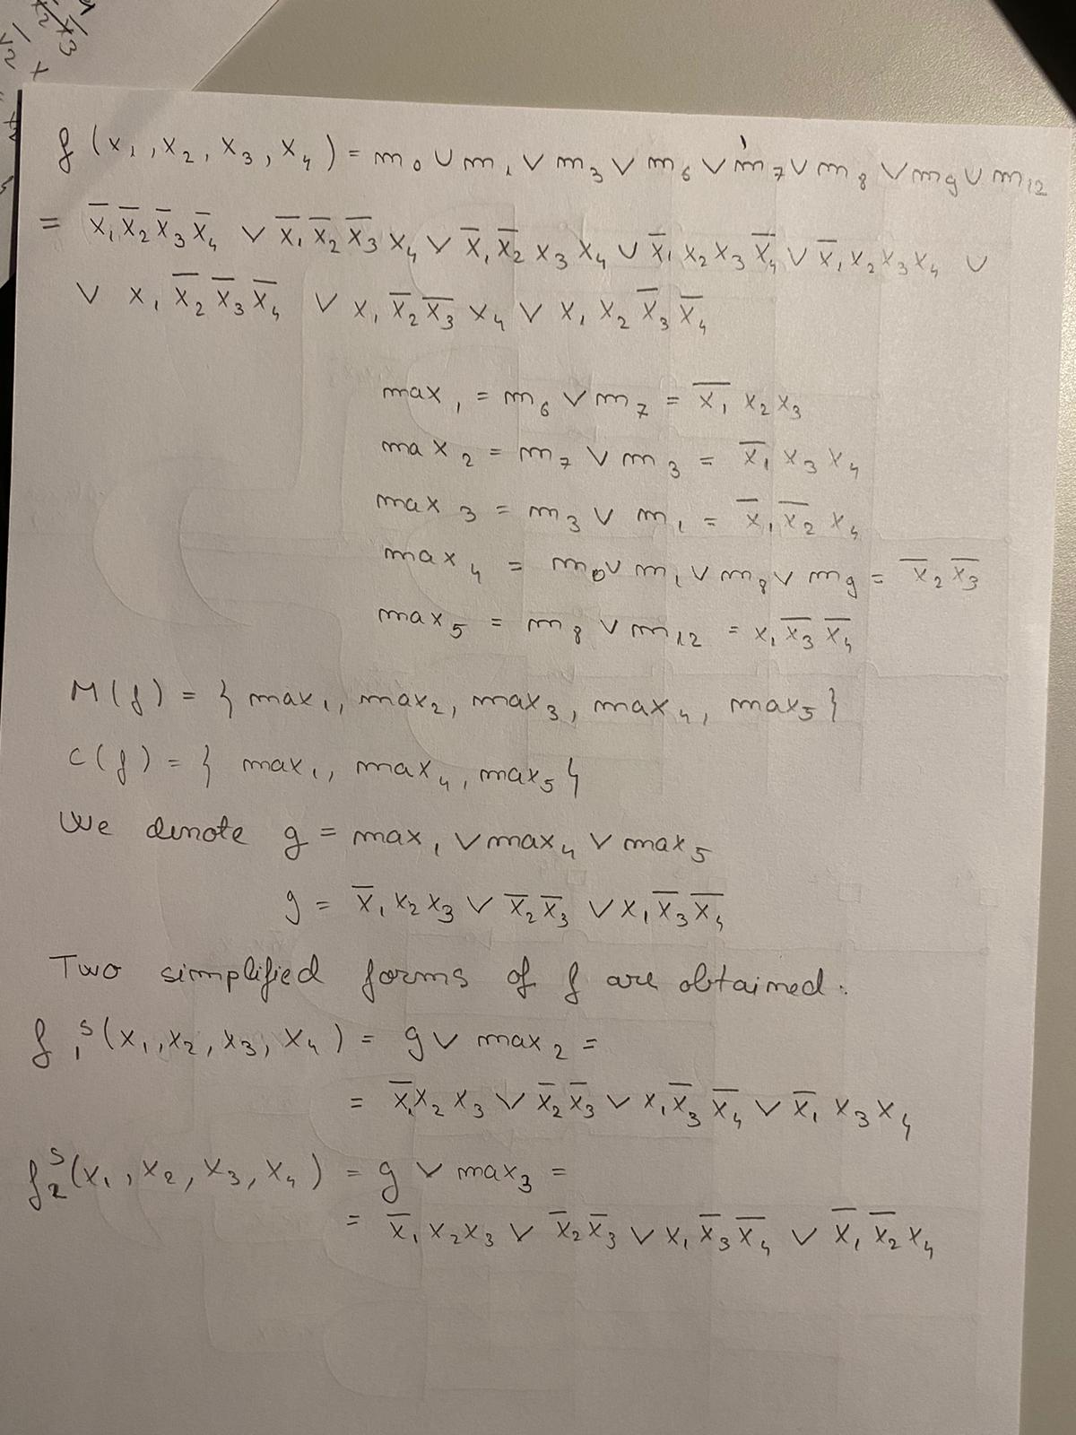
The next step is to write the disjunctive form of the output:

Slide 6
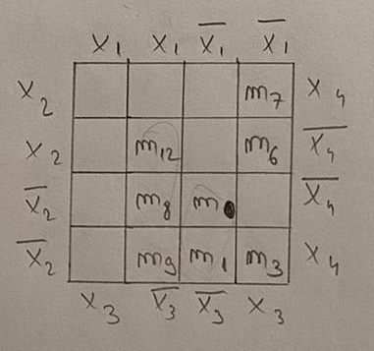
We build the Veitch diagram

Slide 7
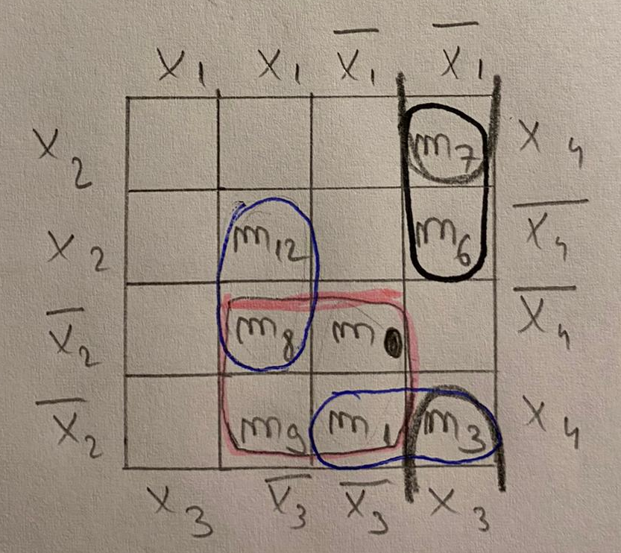
We build the Veitch diagram and write the maximal monoms

Slide 8
We look after central monoms and write the simplified forms

Slide 9
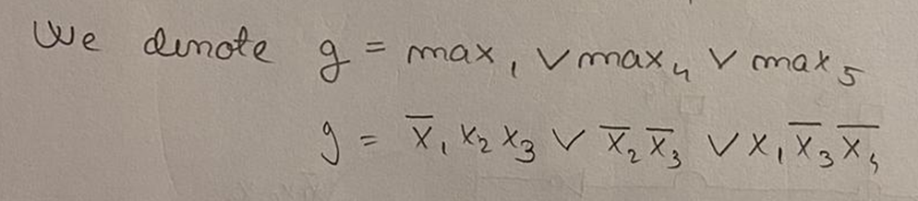
Because M(f) ≠ C(f) and C(f) ≠ Ø we have the second case of simplification algorithm

Slide 10
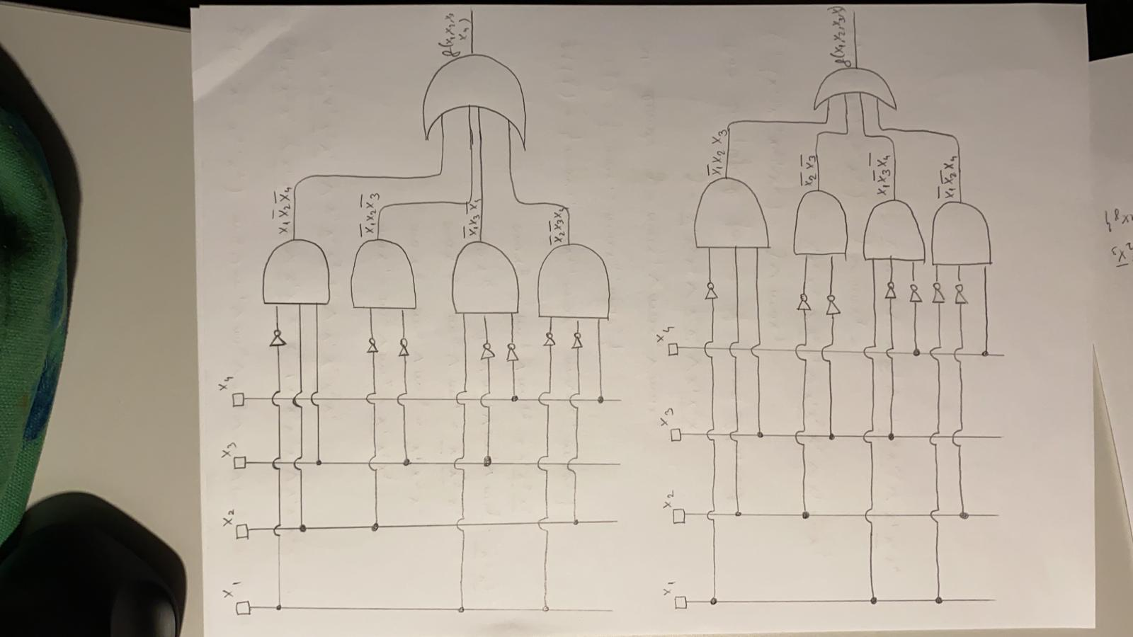
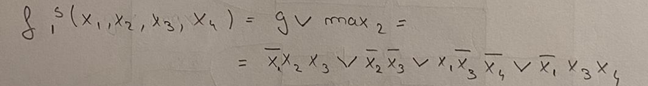
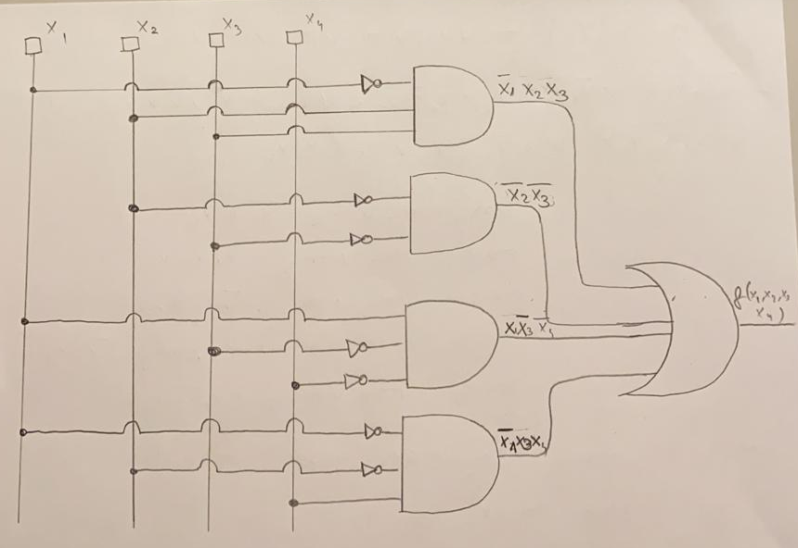
Last step is to draw the logic circuit of both simplified forms

